Slide 1

SmartyDo
Your preferred Task Manager
Presenters:
Filbert
Moon
Matthew
Kenneth

Slide 2
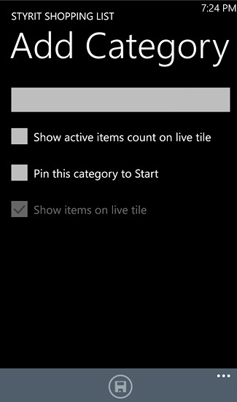
Product categories currently in the market
Grocery List
Getting Things Done (GTD)
Plain Text

Slide 3

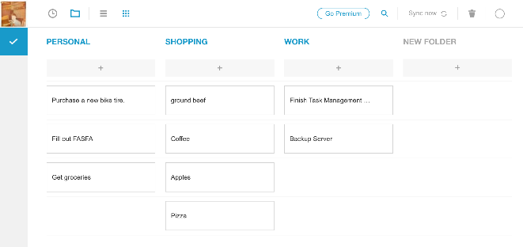
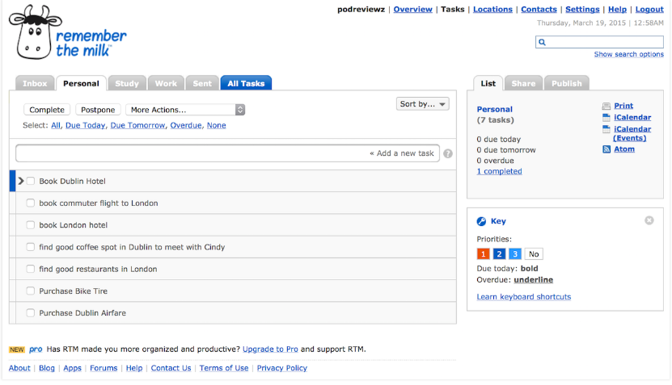
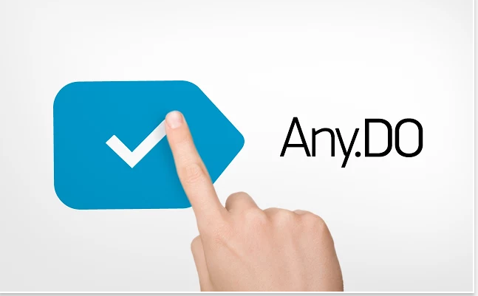
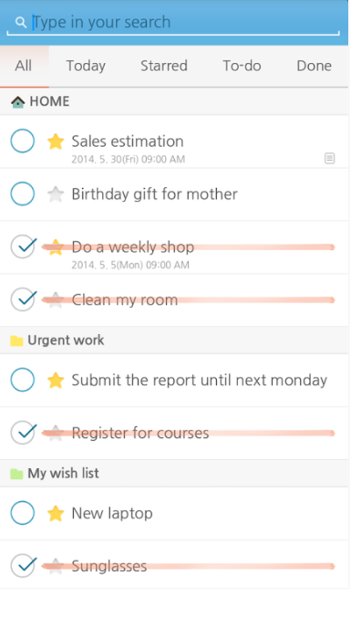
Grocery List
Remember the milk
Advantages
Simple listing of tasks
Minimal description
Focus on what needs to be done
SomToDo

Slide 4
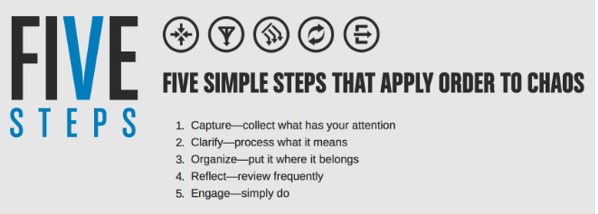
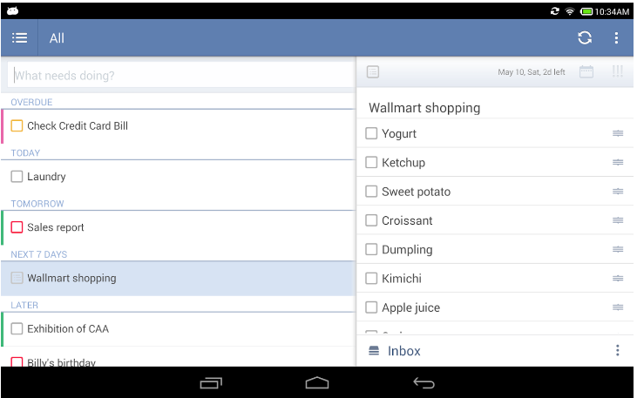
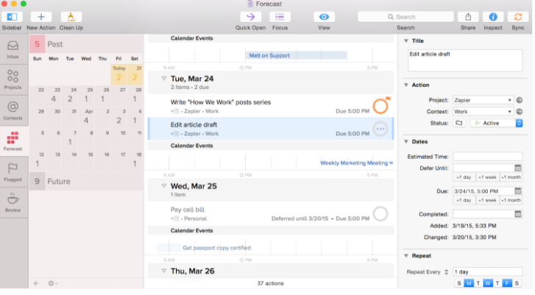
Getting Things Done (GTD)
TickTick
OmniFocus

Slide 5
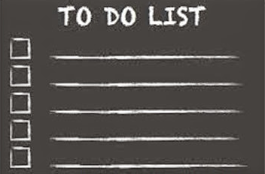
Users who…
Desire minimalistic, no frills software
Prefers typing over clicking
Receive frequent spontaneous requests
Seek to improve their productivity
Yearn for information privacy

Slide 6
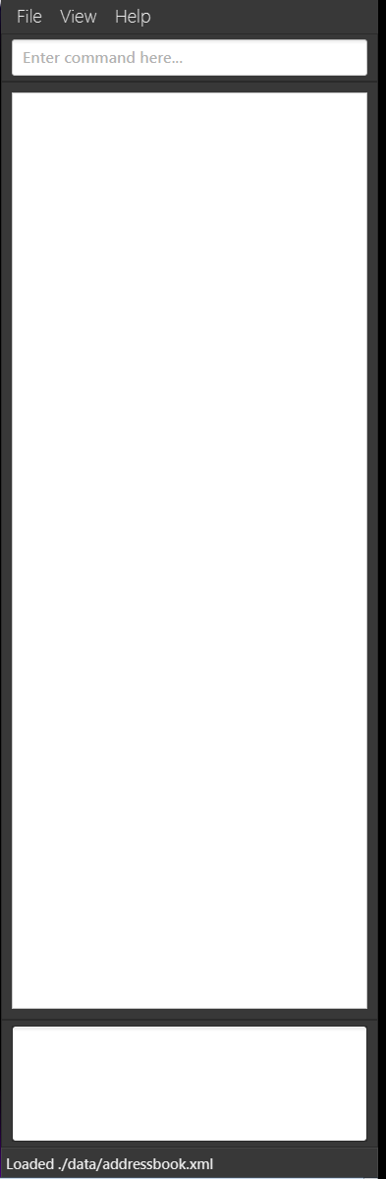

Our Solution: Plain Text Style
Minimalistic with detailed description
Offline application
Flexible tracking of tasks
Smarty Do

Slide 7
Our Two Design Principle

Slide 8
The Elves and the Shoemaker Design Principle

Slide 9
Just Enough is Enough Design Principle

Slide 10
“This is exactly what I need!”

Slide 11
Is There a Catch?

